Slide 1

HYBRID CLOUD

Slide 2
Advantages of Private Cloud
deeper visibility of the total IT environment,
the end-to-end controllability,
the guaranteed performance and dependability with nil network latency,
all, impenetrable, and fool-proof security,
Advantages of Public Cloud
web-scale, cost-effective,
being manned by trained, experienced and skilled experts,
being continuously standardized toward open, interoperable, connected, and federated clouds.

Slide 3
Hybrid Cloud Adoption
In order to attain the combined benefit of both public and private clouds.
rolled out by establishing a linkage between traditional IT infrastructures, private and public clouds, and third-party services.
vendor lock-in issue is being attended through hybrid cloud strategy
Strategies for Cloud Adoption
data locality and security, workload performance and
throughput, and network latency,

Slide 4
FEDERATED CLOUD

Slide 5
Cloud Federation
refers to the runtime synchronization of software, platform, and infrastructure services from geographically distributed and disparate cloud toward fulfilling specific business demands.
Brokers and network gateways - most important gluing and fusing mechanisms for federating multiple clouds.
Selecting a cloud service provider for a particular workload in terms of affordability, availability, and amenability.

Slide 6
Benefits of cloud federation
Enlarged utilization of cloud resources
The real value of distributed computing through an integrated and centralized dashboard
Composite and process-aware services
disaster and data recovery tasks – simplified
Fault-tolerance toward business continuity, resource clusters and grids,
scale-out or horizontal scalability,
policy-based activation

Slide 7
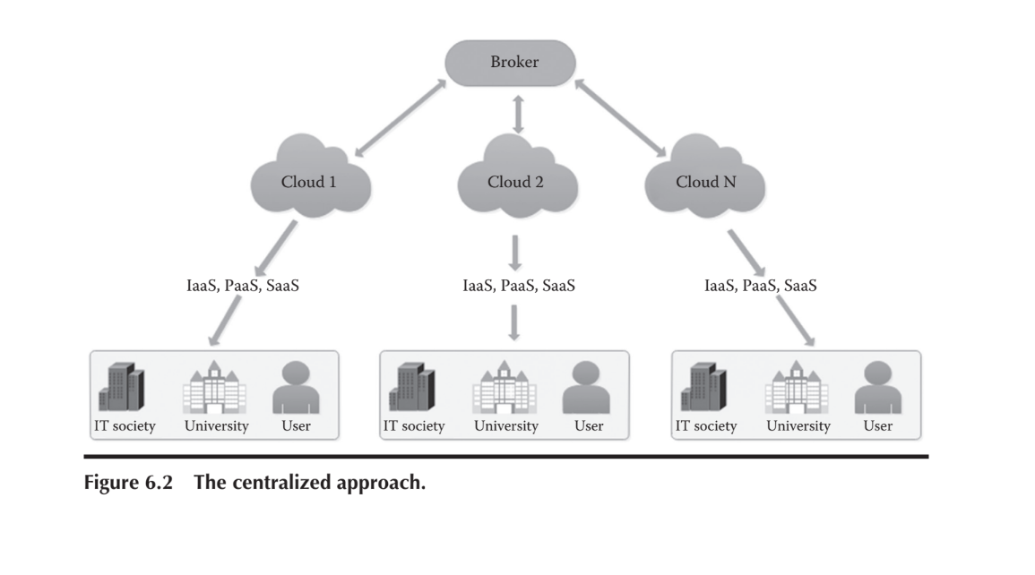
Cloud Federation approach 1
cloud brokers find to bind and create a cloud federation out of multiple clouds to fulfill the requirement.

Slide 8
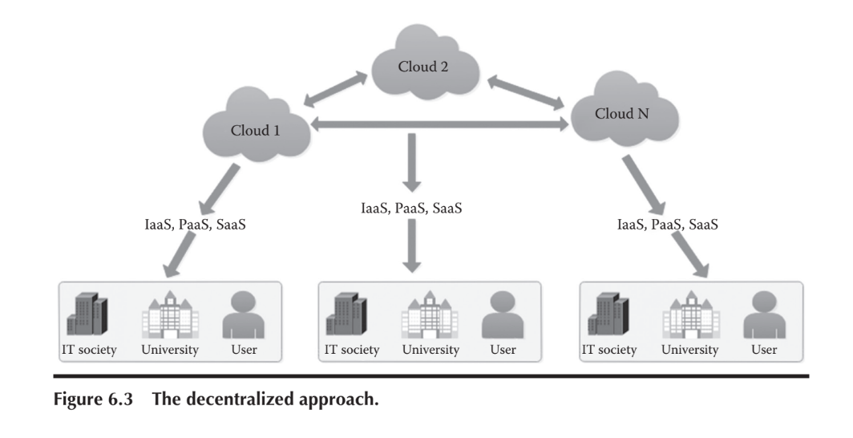
Cloud Federation approach 2
clouds, in a peer-to-peer manner, negotiate themselves to establish the required partnership to have a cloud federation.

Slide 9
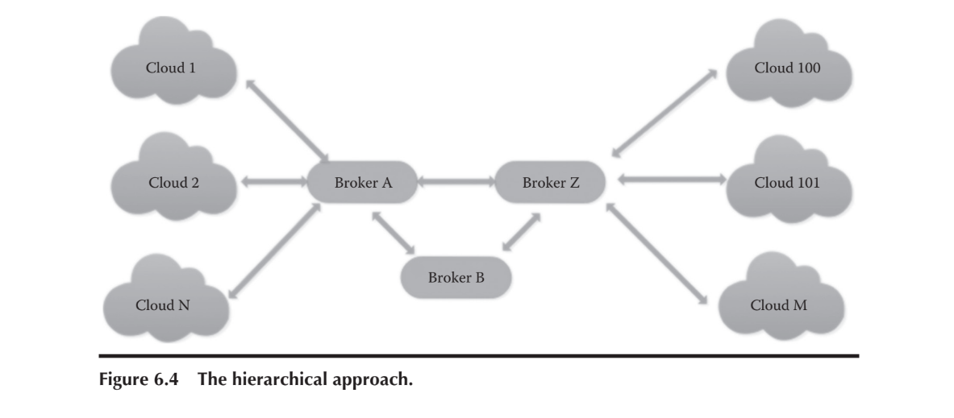
Cloud Federation approach 3
Clouds are connected to a broker and each broker can also interact with other brokers in order to look for fitting clouds for realizing the cloud federation.

Slide 10
SPECIAL PURPOSE CLOUD

Slide 11
Examples
mobile backup clouds for stocking up all kinds of mobile messages, videos, audio clips, photos,e-mails, and so on.
Dropbox for storing all kinds of files of Android
phones.
iCloud for connecting to Apple devices in amazing ways.
iCloud photo library and iCloud drive keep photos, videos, and documents stored securely

Slide 12
Use Case of Device clouds
All kinds of devices in our every environment are getting hooked to faraway clouds to be accordingly empowered by cloud-based services and data.
Device data – shared with cloud-based analytics databases and platforms(cost-effective and elastic)
can be a mobile testing environment that enables developers to remotely evaluate the performance of applications on a wide range of smart devices.
The device cloud gives organizations access to modern and legacy devices so that they need not expend on buying, installing, configuring, and operating a variety of devices in their own backyards.
Eg:Wind River Helix Device Cloud

Slide 13
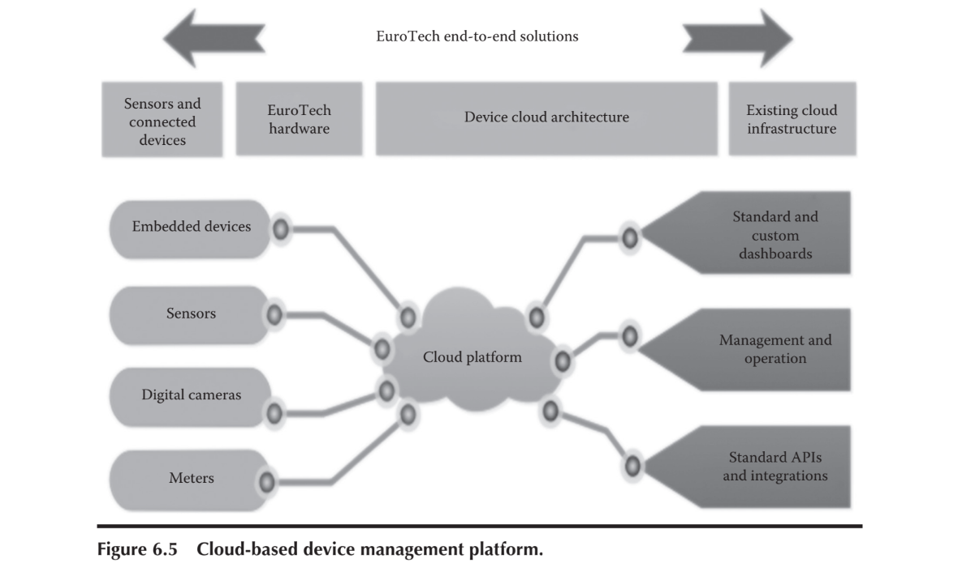

Slide 14
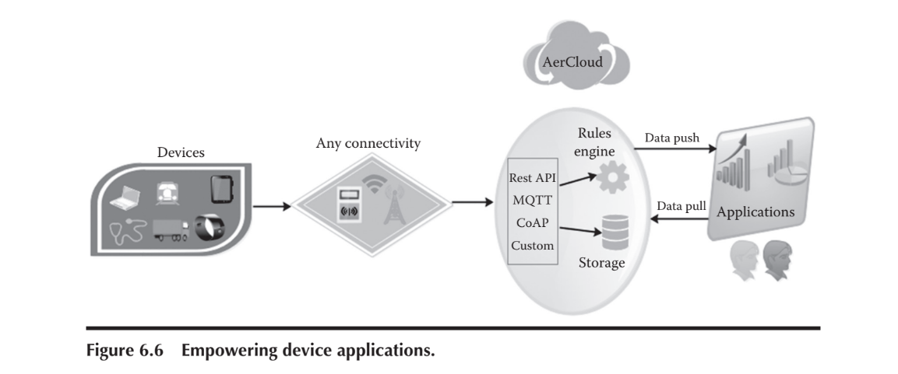
integrates that data with other systems and data sources, which it then uses to automate control of IoT devices and machines.
with device cloud, organizations can easily update hundreds or thousands of devices through remote software updates.

Slide 15
The Eurotech Everyware Device Cloud (EDC) is an end-to-end solution (Figure 6.5) that includes purpose-built hardware, connectivity, and embedded device management through the Eurotech Software Framework, the Everyware Device Cloud Client, and machine-to-machine (M2M) cloud-based services to deliver actionable insights from the field to downstream applications and business processes, dashboards, and reports.
Cloud database - fault-tolerant and elastically scalable.
data filtering, continuous queries, aggregation and correlation between devices, and event pattern recognition to ensure rapid reaction to business-critical situation scenarios
The Health Suite digital platform [http://www.usa.philips.com/healthcare] represents a new era in connected health care for both patients and providers, as health care continues to move outside the hospital walls, and into our homes and everyday lives.( supported by salesforce.com )

Slide 16

Thank you

